Slide 1


Article 2: “All children have these rights, no matter who they are, where they live, what their parents do, what language they speak … what their culture is ... No child should be treated unfairly on any basis.”
–
Parents/Carers & Pupils:
This lesson works best in “Full Screen” mode – click the icon at the bottom right of your screen or use the “F5” key to start from the beginning. Use the space bar, mouse or arrow keys to click through!

Slide 2






How to use this lesson…
Use these buttons to get the most out of your lesson.
Find this button in the bottom right of you screen to start your lesson.
Use the arrow keys to go forwards and backwards through your lesson.
To go back to your normal screen, press the esc key on your keyboard.
–
Learning from home?
Here are some ideas of how to get the most out of this lesson at home.
Ask an adult to arrange a video call so you can do some
of the activities with a friend.
Explore the topic with a parent or caregiver: how is their opinion
different to yours?
Teach a younger sibling or relative
about how
VotesforSchools works!
In the classroom?
Look out for these boxes to see how to make the most of the activities!
Parents’ & Carers’ Note:
Please see the Notes section below each slide for any further guidance.
Don’t forget to vote…
You can find the link to do this on the final slide. Get your whole household involved!
Notes:
Images:
https://icons8.com/

Slide 3



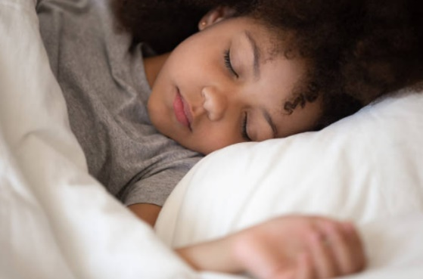
Feedback: “Do you get enough sleep?”
“I have not been getting nearly as much sleep as I should. Because of quarantine, staying at home for a long time has caused me to change my sleeping cycle … therefore I have been feeling very grumpy and angry at everyone for almost no reason at all. However, if I try the techniques, I am almost completely sure that I will have a better sleeping cycle.”
South Grove School
31.2%
68.8%
“I think this is a very good topic because many children in Year 6, before lockdown, were constantly late night studying for SATs resulting in less sleep.”
Beam County Primary School
“Sometimes I do but It all depends on what I’m thinking about - if I cant get something upsetting or scary on my mind I can’t sleep.”
St Nicholas CE Primary School
Sleeping differently? You’re not the only one! A study found that up to 70% of children under 16 are going to bed later and 57% are also waking later!
Notes:
Parent/Carer Note: This slide shows the feedback to the question pupils answered two weeks ago. Check back in two weeks to see if the comment you make at the end of this lesson is featured!
To record your child’s vote, use the survey link on the last slide or use the hashtag #VotesatHome on social media to browse other children’s responses and share your own.
References:
1) Sleep: https://www.bbc.co.uk/newsround/52506961

Slide 4


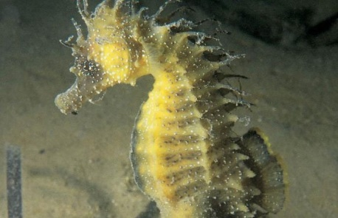
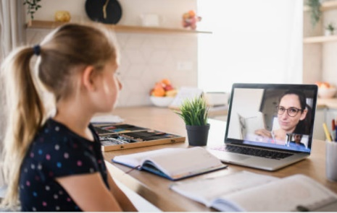



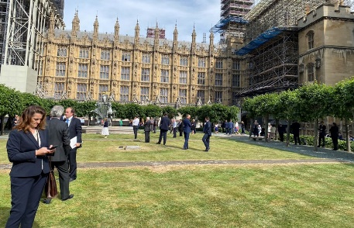

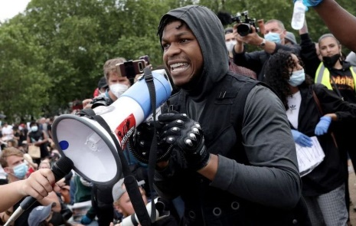
Be informed!
Here’s what’s been in the news this week...
Endangered seahorses return to UK!
Sony delays PS5 announcement
An endangered species of seahorse native to the UK has been spotted in British waters for the first time in more than two years.
Sony decided to delay their PS5 announcement to “allow more important voices to be heard”, showing their support for recent protests.
Members of Parliament queued for 90 minutes last week to cast a vote after they were told they could not vote online. Lots of people complained!
Stars Wars actor John Boyega joined protests in London last week. You’ll find out more about this in this lesson!
MPs queuing to go back to work
John Boyega protests
Notes:
Parent/Carer Note: Use this slide to learn about headlines around the world. Using the presentation in Slide Show mode, you will be able to click on the highlighted pictures to follow links to websites and videos.
Images/Stories:
Seahorses; https://www.bbc.co.uk/newsround/52912416
PS5: https://www.bbc.co.uk/newsround/52889513
https://www.bbc.co.uk/newsround/52917632
https://www.theguardian.com/politics/2020/jun/02/mps-join-90-minute-long-queue-to-vote-to-end-virtual-voting

Slide 5







Starter: Is it fair?
Is it fair? (3-5 mins)
Look at each of these actions and use your thumbs to show whether you think that they are fair or unfair.
Not playing with someone because they have a different skin colour to you.
Helping someone who is from the same country as you before helping others.
Being friends with someone who has a different religion to you.
Using a nickname for someone who comes from a different country.
Being treated the same, regardless of your race or religion.
Asking questions about someone’s culture when it is different to yours.
Notes:
Parent/Carer Note: This activity aims to encourage children to consider fairness and equality in scenarios that are age appropriate.

Slide 6
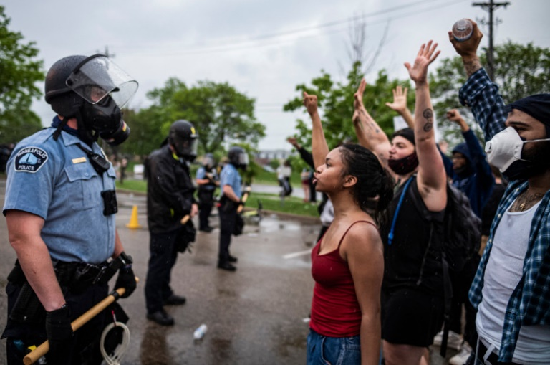
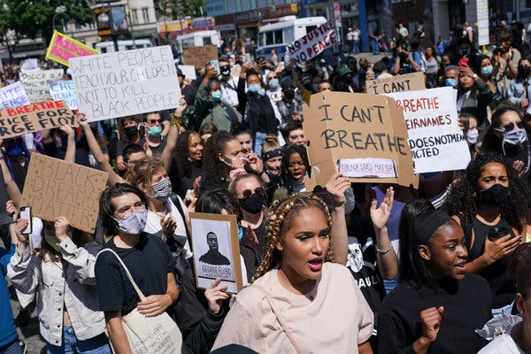

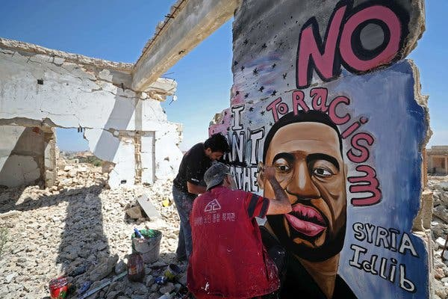
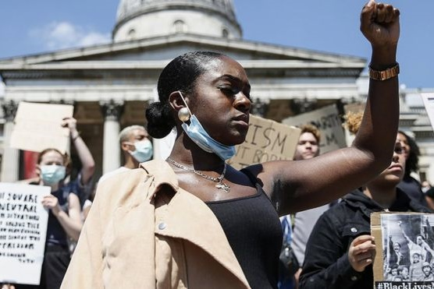
Will the recent anti-racism protests lead to change in the US?
Please Note:
This lesson discusses racism and inequality in America and may be upsetting or unsuitable for some pupils. Please review before use.
Notes:
Parent/Carer Note: Each week, your child completes this lesson in school before recording their vote on an online platform. Temporarily, we have created a platform you can use at home. Please see the last slide for details.
We recommend that you read through the lesson before sharing it with your child.
Images:
iStock
https://thenypost.files.wordpress.com/2020/05/052920-minneapolis-floyd-protests-11.jpg?quality=90&strip=all&w=814
https://www.bbc.co.uk/news/newsbeat-52877803

Slide 7





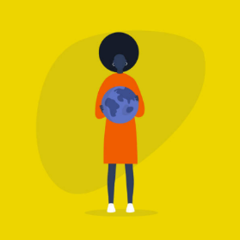
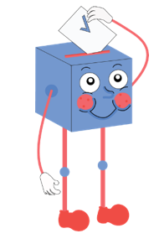
Starter: Is it fair?
What is
racism?
Is a change coming?
Why are we talking about this?
Standing up, speaking out
Vote!
Notes:
Images:
iStock

Slide 8




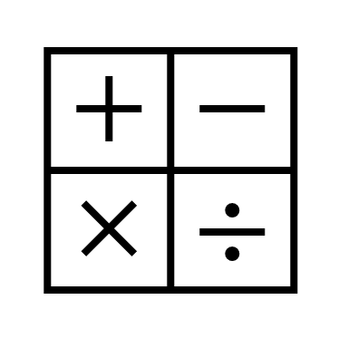

What is racism?
Have you heard? (3-5mins)
Read through these comments. Have you heard anything like them before? What’s wrong with them?
Don’t be a Jew!
He can’t help it. That’s just what black people are like!
All white people are like that.
Go back to your own country!
All brown people are good at maths!
You can’t play with us because you don’t speak our language.
These are all racist comments. If you hear something like this you should tell the person that this is racist and inform an adult about the comment.
Notes:
Parent/Carer Note: It is important that children recognise racism in its different forms and understand that it is not acceptable.
Images:
The Noun Project

Slide 9
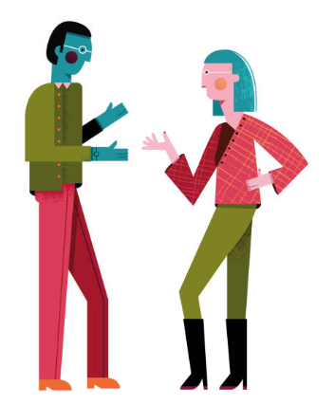
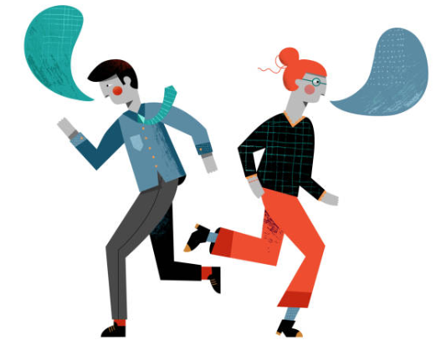
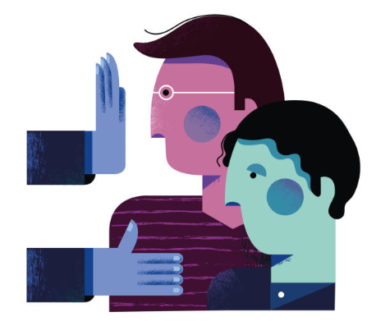
What is racism?
Racism is where someone thinks you’re not good enough because of your colour, ethnicity, nationality or race. This could mean that they treat you differently (racial discrimination) or bully you because of your race, ethnicity or culture.
As we grow up, we learn from our friends, family and things we see all around us. If someone sees or hears racist comments or jokes, they might think that this is normal and start doing it too.
Silent question (1 min)
In your head, think carefully. Have you ever seen behaviour like this? What happened and how did it make you feel? You do not need to share your answer if you don’t want to.
Racism can also begin as a reaction to the news or a personal experience – for example, if someone had an argument with a green person, they might start to think all green people are unkind. This is racism too.
Notes:
Parent/Carer Note: The information provided has been taken from the Childline website, referenced below.
References:
1) https://www.childline.org.uk/info-advice/bullying-abuse-safety/crime-law/racism-racial-bullying/
Images:
iStock

Slide 10





What is racism?
Racism is more than just saying upsetting things. When people in a society hold racist views, it can affect the way the whole country works. We call this systemic racism.
Systemic racism can be more difficult to see in person, but there are lots of facts and figures that suggest that it is happening in countries like the US. For example:
Black Americans are 2x more likely to be unemployed than white Americans¹.
Black Americans are 3x more likely to be excluded from school than white Americans².
Only 13% of people in the US are black, yet 40% of the people in prison are black³.
72% of white Americans own their own house, whereas only 42% of black Americans do⁴.
Black Americans are 30% more likely to be pulled over by the police when driving⁵.
Question (1 min)
How do these statistics make you feel? Why?
Challenge:
Imagine that you were a black person living in America. How would you feel about these facts? What would you want to happen?
Notes:
Parent/Carer Note: Whilst upsetting, this slide is necessary for young people to understand how racism manifests in society.
References:
https://www.statista.com/statistics/194151/unemployment-rate-of-african-americans-in-the-us-since-1990/
https://www.npr.org/sections/codeswitch/2014/03/21/292456211/black-preschoolers-far-more-likely-to-be-suspended/?t=1591093789612
https://www.huffpost.com/entry/black-crime-rates-your-st_b_8078586?guccounter=1
https://www.chicagotribune.com/business/ct-black-homeownership-plunges-0723-biz-20170720-story.html
https://www.washingtonpost.com/news/wonk/wp/2014/09/09/you-really-can-get-pulled-over-for-driving-while-black-federal-statistics-show/
https://www.benjerry.com/whats-new/2020/05/democracy-covid-19

Slide 11
Starter: Is it fair?
What is
racism?
Is a change coming?
Why are we talking about this?
Standing up, speaking out
Vote!
Notes:
Images:
iStock

Slide 12
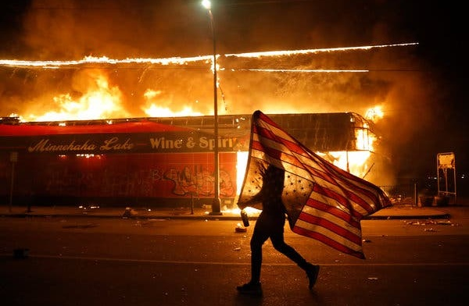
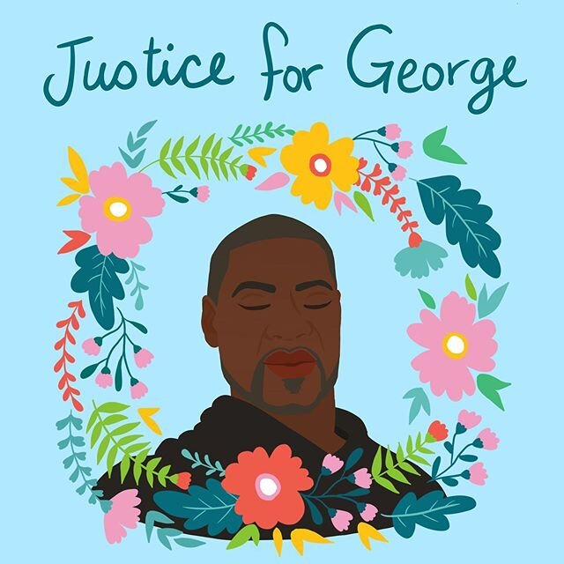
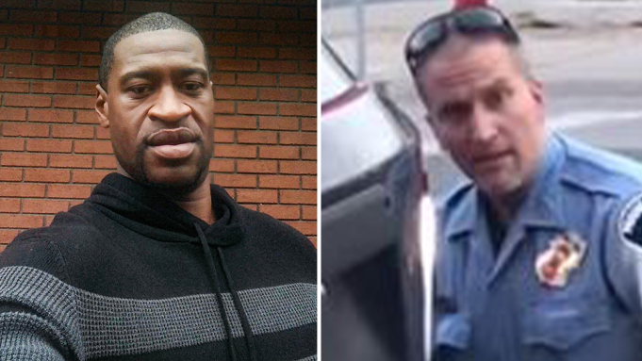
Why are we talking about this?
Recently, there have been protests across America, in the UK and in other countries around the world. Many of these have been peaceful, but there have also been fires and violence.
The protests began as a response to the death of a man named George Floyd in Minneapolis, a city in the US. A former Minneapolis police officer has been arrested and charged with murder over George’s death.
Derek Chauvin, who is white, was shown kneeling on George Floyd's neck before he died in a video shared on social media. Since the protests started, he and three other officers have been arrested.
Notes:
Parent/Carer Note: Use this slide to understand the context behind this week’s lesson.
References:
Wording directly taken from: https://www.bbc.co.uk/newsround/52813673
Images:
iStock

Slide 13
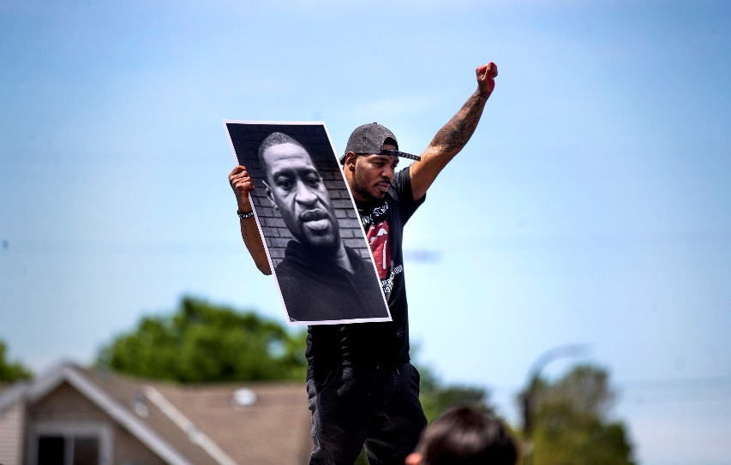
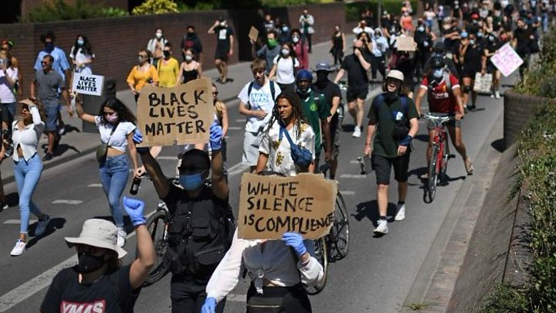
Why are we talking about this?
Since George Floyd’s death, protests have taken place across lots of other countries¹, even though many of these cities are in lockdown or are practicing social distancing.
These protests are not the first time the Black Lives Matter movement has had to take to the streets to demand change. The group was set up in 2013² and have held many other protests since then.
However, lots of people feel like this time will be different – that more people are taking notice and understanding the importance of not just being “non-racist” but being “anti-racist”. So will this time finally bring an end to racism?
Notes:
References:
https://www.npr.org/2020/05/31/866428272/george-floyd-reverberates-globally-thousands-protest-in-germany-u-k-Canada
https://blacklivesmatter.com/about/
https://www.buzzfeednews.com/article/susiearmitage/2016-was-the-year-black-lives-matter-went-global
Images:

Slide 14
Starter: Is it fair?
What is
racism?
Is a change coming?
Why are we talking about this?
Standing up, speaking out
Vote!
Notes:
Images:
iStock

Slide 15


Is a change coming?
As you’ve seen, many people have said that the protests that are happening after the death of George Floyd are different to past protests about racism. But what exactly is different, and is it enough to lead to a change in the US?
Is a change coming? (10-15 mins)
Over the next few slides you are going to learn more about the protests that have been happening around the world. For each slide, decide how likely you believe it is that this will create change in America.
Does this show change could be happening?
1
2
3
4
5
6
7
8
9
10
Not at all
Definitely

Slide 16
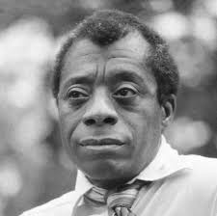
Is a change coming?
Black people in America have been fighting against racism for hundreds of years, and yet it still exists.
Changes have happened, but they have often been very slow. For example, Martin Luther King Jr started fighting for equality over 50 years ago, but the struggle is still happening today.
0:00-0:22
Watch (1 min)
Watch the clip of James Baldwin talking about the fight for equality in the US from over 30 years ago. Then, answer these questions.
How was James feeling in this video?
Do you think James would say the same thing today? Why/why not?
Does this show change could be happening?
1
2
3
4
5
6
7
8
9
10
Not at all
Definitely
https://safeshare.tv/x/OCUlE5ldPvM
Notes:
Alternative video link: https://www.youtube.com/watch?v=OCUlE5ldPvM
Images
https://en.wikipedia.org/wiki/James_Baldwin
References
https://www.history.com/topics/black-history/black-history-milestones

Slide 17
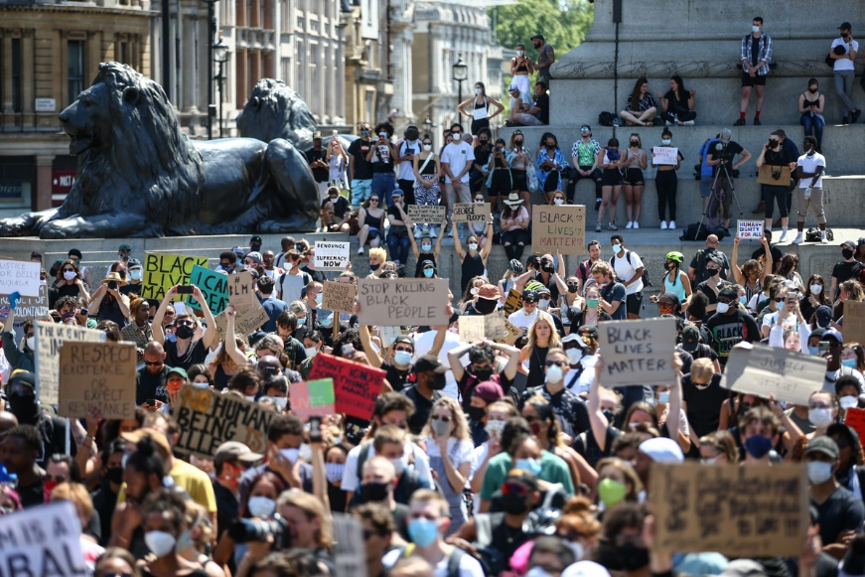
Is a change coming?
Anti-racism protests aren’t only happening in America – they’re happening across the whole world.
UK
Syria
This means that many more people are learning about racism and are taking a stand against it.
Does this show change could be happening?
1
2
3
4
5
6
7
8
9
10
Not at all
Definitely
Notes:
Images & References:
1) https://www.nytimes.com/2020/06/01/world/asia/george-floyd-protest-global.html

Slide 18
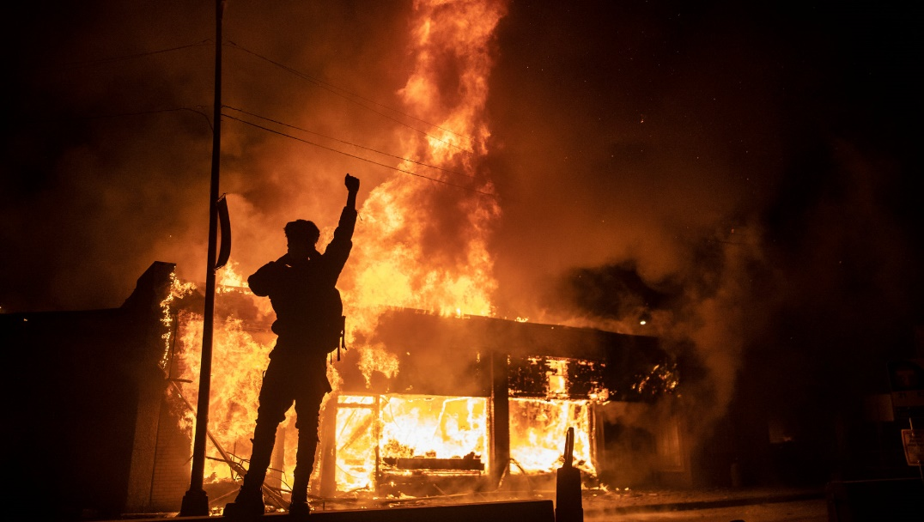
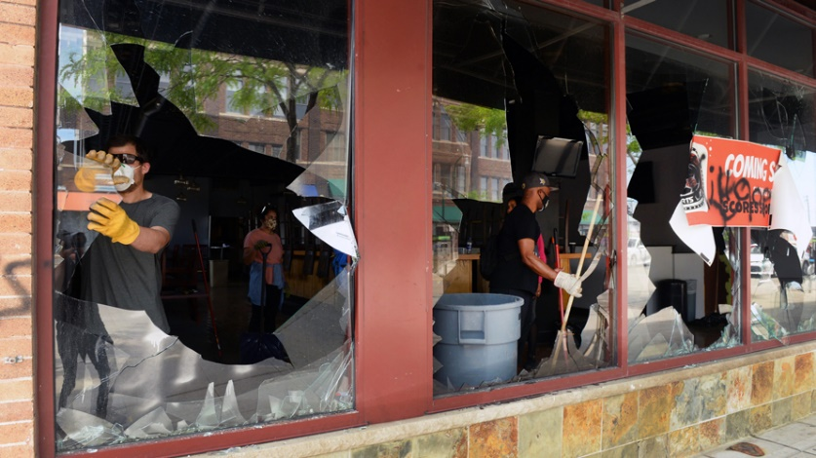
Is a change coming?
Despite protests starting peacefully, a few have turned violent, with buildings being set on fire and shops being looted.
Looting:
Stealing from shops during a violent event.
Other reports say that protests only became violent after police officers tried to stop them from happening, or that violence was started by non-protesters. However, it is impossible to know the truth.
Some people have said that violence doesn’t help the protestors as it just makes people angry at them. However, others have argued that peaceful protests haven’t worked in the past, causing this to happen.
Does this show change could be happening?
1
2
3
4
5
6
7
8
9
10
Not at all
Definitely
Notes:
Images & References:
https://dictionary.cambridge.org/dictionary/english/looting
https://www.nytimes.com/2020/05/31/opinion/letters/unrest-minnesota-george-floyd.html
https://www.adweek.com/retail/despite-their-differences-americans-agree-brands-should-help-small-businesses-impacted-by-looting/
https://www.theguardian.com/us-news/2020/may/31/george-floyd-protesters-condemn-opportunistic-looting-violence
https://www.telegraph.co.uk/news/2020/06/01/looting-wake-brutal-murder-provokes-yet-injustice-america/

Slide 19
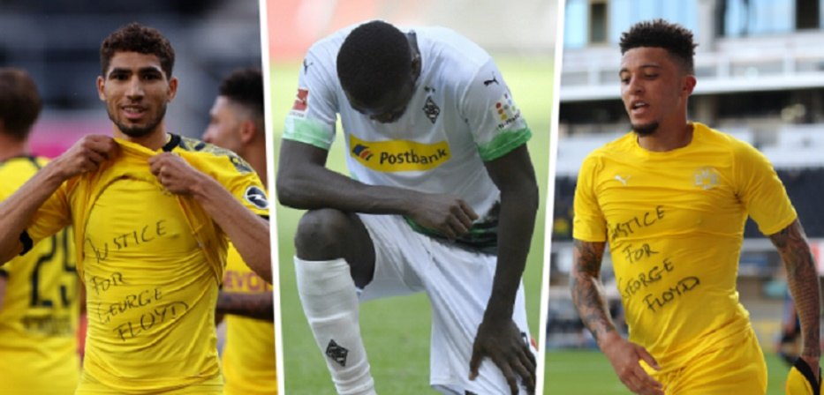
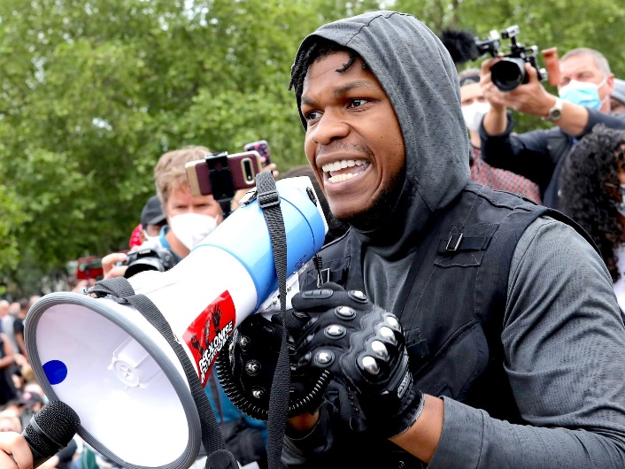
Is a change coming?
Influential figures, such as footballers & singers, and companies have spoken out about it, which has helped spread awareness.
It has also been discussed on TV shows, radio channels and across vlogs, making it the most talked about topic in the last few weeks.
Challenge:
Have you seen or heard anyone speaking about racism recently?
Does this show change could be happening?
1
2
3
4
5
6
7
8
9
10
Not at all
Definitely
Notes:
Images & References:
https://www.elle.com/culture/celebrities/a32728893/ariana-grande-la-black-lives-matter-protest-photos/
https://www.bbc.co.uk/sport/football/52889540
https://www.insider.com/john-boyega-london-black-lives-matter-protest-video-photos-2020-6

Slide 20
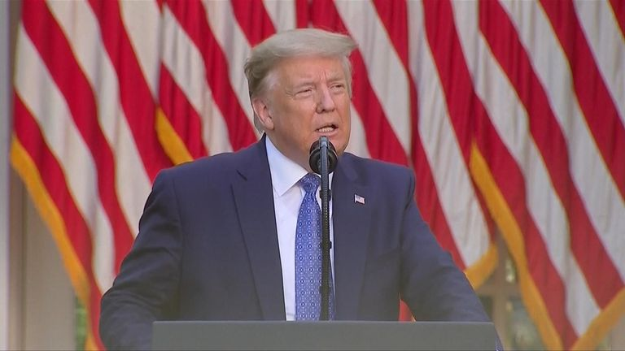
Is a change coming?
With protests turning dangerous, US President Donald Trump said he was “sickened” by the death of George Floyd and that “justice will be served¹”.
He also said he would be sending the army in to end violent protests¹, and tweeted that he had done more for Black Americans than most other presidents³.
However, many people are angry and feel that the American Government is not doing enough to tackle racism in America³.
Does this show change could be happening?
1
2
3
4
5
6
7
8
9
10
Not at all
Definitely
Notes:
*Donald Trump’s full speech here: https://www.youtube.com/watch?v=pQFotIUg5MA
Images:
1)
https://news.sky.com/story/george-floyd-death-donald-trump-will-send-in-the-army-if-cities-fail-to-deal-with-protests-11998929
References:
https://www.bostonglobe.com/2020/06/01/nation/trump-vows-crack-down-protesters/
https://www.washingtonpost.com/politics/2020/06/03/after-years-offending-trump-becomes-defensive-about-his-legacy-regarding-black-americans/

Slide 21
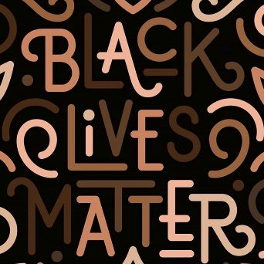
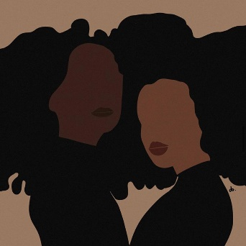
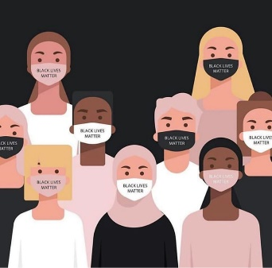
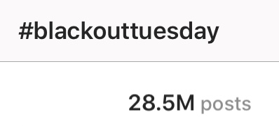
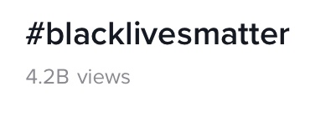
Is a change coming?
Social media has been more involved than ever before, with billions of people from all different races supporting the protests and standing up for the rights of black people.
Last week, there were over 19 million posts on Instagram using the hashtag #BlackLivesMatter and more than 4 billion views on TikTok.
And on Tuesday 2nd June, more than 20 million people took part in an online “blackout” to show that they supported the protests.
Does this show change could be happening?
1
2
3
4
5
6
7
8
9
10
Not at all
Definitely
Notes:
Parent/Carer Note: Statistics were correct at time of release.
Images:
Instagram
TikTok

Slide 22
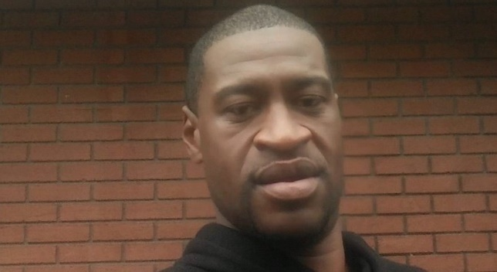

Is a change coming?
A petition was started on change.org demanding justice for George; it wants to make sure the police officers that were involved are arrested and taken to court.
This petition had over 15 million signatures last week, and is the biggest petition that change.org has ever had.
Does this show change could be happening?
1
2
3
4
5
6
7
8
9
10
Not at all
Definitely
Notes:
Parent/Carer Note: Statistics were correct at time of release.
Images & References:
1) https://www.change.org/p/mayor-jacob-frey-justice-for-george-floyd

Slide 23
Is a change coming?
Reflect (3-5 mins)
Think about all the evidence that you have seen so far. All together, do you think it shows a change is happening? Why/why not?
1
2
3
4
5
6
7
8
9
10
Not at all
Definitely
Challenge:
Think back to the statistics that you saw at the beginning of the lesson. What changes do you think need to be made to end systemic racism in America?
Black Americans are 2x more likely to be unemployed than white Americans¹.
Black Americans are 3x more likely to be excluded from school than white Americans².
Only 13% of people in the US are black, yet 40% of the people in prison are black³.
72% of white Americans own their own house, whereas only 42% of black Americans do⁴.
Notes:
Images & References:
1) https://www.change.org/p/mayor-jacob-frey-justice-for-george-floyd

Slide 24
Starter: Is it fair?
What is
racism?
Is a change coming?
Why are we talking about this?
Standing up, speaking out
Vote!
Notes:
Images:
iStock

Slide 25
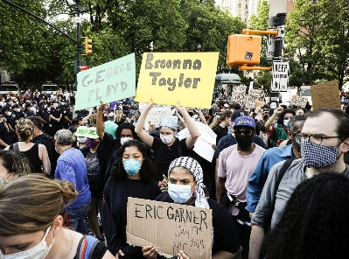
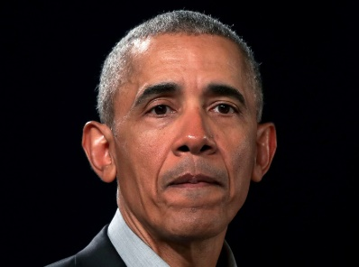
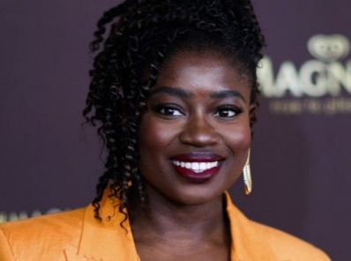
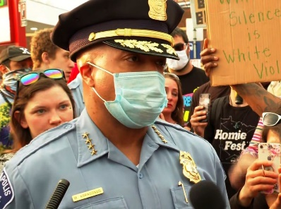
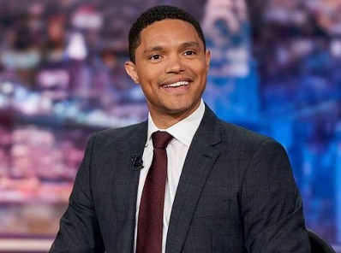


Standing up, speaking out
As you’ve already seen, more people than ever are standing up and speaking out against racism in America and in their own countries… but what’s being said?
I think that…
Think! (5-10 mins)
Take a look at the different opinions on the next few slides and see if you can answer the questions in the bubbles.
I’m not sure about…

Slide 26
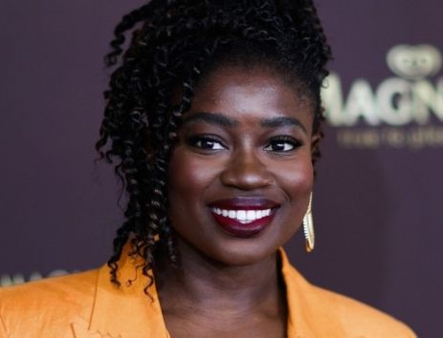
Standing up, speaking out
Clara Amfo
BBC Radio 1 Host
Events like this make me and other black people feel like you want our culture but you don’t want us. If you enjoy our culture, you must stand up for our rights too.
Culture:
The way of life of a group of people.
I think that…
I’m not sure about…
Do you agree with Clara? Should everyone stand up for black people’s rights?
Notes:
*Quotes have been simplified for a young audience. See full quote below:
https://www.youtube.com/watch?v=aELGfhgaNpI
Images:
https://www.bbc.co.uk/news/entertainment-arts-52890690

Slide 27

Standing up, speaking out
Medaria Arradondo,
Chief of the Minneapolis Police
What happened to Mr Floyd was wrong. There were three other officers there that didn’t stop it from happening, so they’re complicit too.
Complicit:
Involved in/knowing a crime is happening.
I think that…
Do you agree with Medaria? Are the police who were there for George Floyd’s death “complicit”? How might a police chief saying this cause a change?
I’m not sure about…
Notes:
*Quotes have been simplified for a young audience. See full quote below:
“…What occurred out here last Monday was wrong […] Mr Floyd died in our hands, and so I see that as being complicit. Silence and inaction, you’re complicit. If there were one solitary voice that would have intervened and acted, that’s what I would have hoped for. That did not occur.”
Images
iStock
https://edition.cnn.com/videos/us/2020/06/01/police-chief-medaria-arradondo-full-intv-sidner-vpx.cnn
References
https://medium.com/@BarackObama/how-to-make-this-moment-the-turning-point-for-real-change-9fa209806067
https://www.theguardian.com/us-news/2020/jun/01/george-floyd-death-minneapolis-police-chief-medaria-arradondo-officers-complicit
https://time.com/5845752/america-has-its-knee-on-us-george-floyds-death-was-a-breaking-point-protests/
https://dictionary.cambridge.org/dictionary/english/complicit

Slide 28
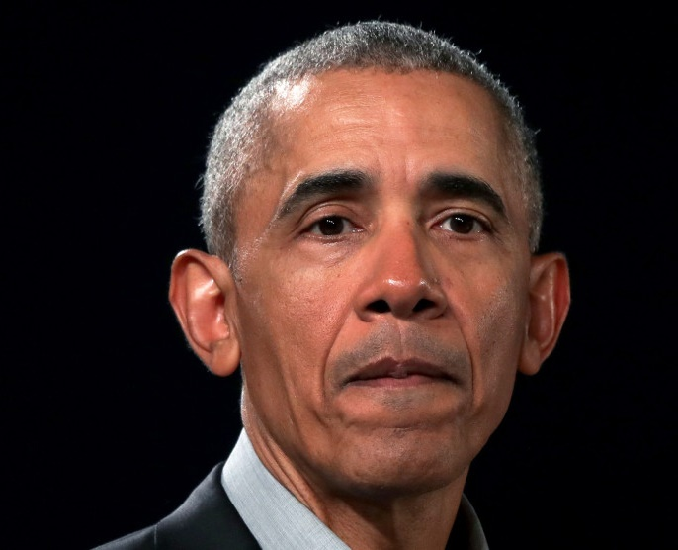
Standing up, speaking out
Barack Obama,
Former President of the United States
Watching everyone, of every race, protest makes me hopeful. We need to turn our anger into peaceful action and change to make our country better.
I think that…
I’m not sure about…
Do you agree with Obama? Will everyone working together help bring change?
Notes:
*Quotes have been simplified for a young audience. See full quote below:
“Watching the heightened activism of young people in recent weeks, of every race and every station, makes me hopeful. “If, going forward, we can channel our justifiable anger into peaceful, sustained, and effective action, then this moment can be a real turning point in our nation’s long journey to live up to our highest ideals. Let’s get to work”
Images
iStock
https://www.motherjones.com/politics/2020/05/barack-obama-george-floyd-minneapolis/
References
https://medium.com/@BarackObama/how-to-make-this-moment-the-turning-point-for-real-change-9fa209806067
https://www.theguardian.com/us-news/2020/jun/01/george-floyd-death-minneapolis-police-chief-medaria-arradondo-officers-complicit
https://time.com/5845752/america-has-its-knee-on-us-george-floyds-death-was-a-breaking-point-protests/

Slide 29
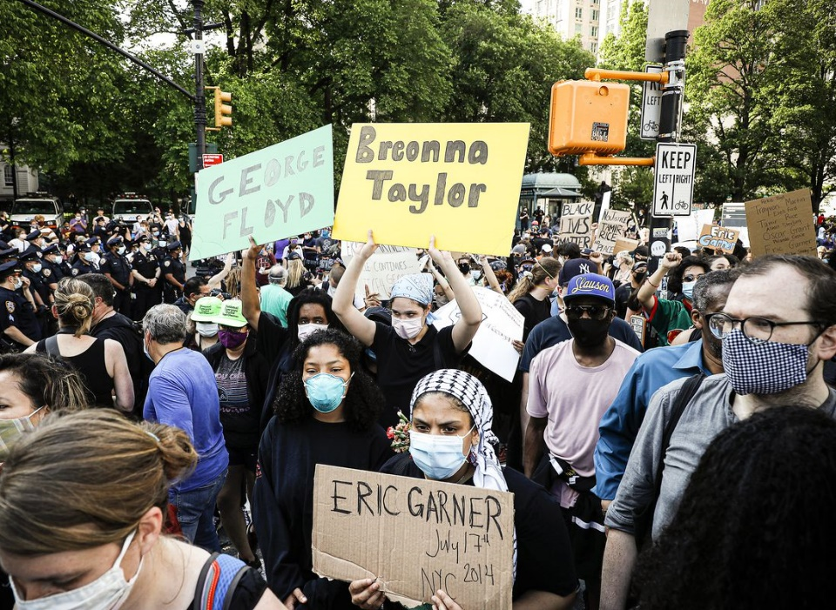
Standing up, speaking out
Priscilla Borker,
Social Worker at the Brooklyn demonstrations in New York
Coronavirus might kill us, but even if it doesn’t the police might. Or losing our jobs and having no money might… So we need to take the risk.
I think that…
I’m not sure about…
Do you agree with Priscilla? How do you think it would feel to live with this fear? Do you think the risks are worth it?
Notes:
*Quotes have been simplified for a young audience. See full quote below:
“It’s either COVID is killing us, cops are killing us, the economy is killing us. Every corner that people of colour turn, they’re being pushed, and so whether we stay home or think about the risk of coming out here in regards to the COVID crisis, either way we’re still being killed. So we don’t mind taking this risk.”
Images
iStock
https://www.vox.com/2020/5/30/21275600/george-floyd-protest-photos-minneapolis-atlanta-new-york
References
https://medium.com/@BarackObama/how-to-make-this-moment-the-turning-point-for-real-change-9fa209806067
https://www.theguardian.com/us-news/2020/jun/01/george-floyd-death-minneapolis-police-chief-medaria-arradondo-officers-complicit
https://time.com/5845752/america-has-its-knee-on-us-george-floyds-death-was-a-breaking-point-protests/

Slide 30

Standing up, speaking out
Trevor Noah
Host of US TV series the Daily Show
People say that this isn’t the way to protest, but what is the right way? There is no “right way” to protest because you are against the system.
I think that…
I’m not sure about…
Do you agree with Trevor? Is there a “right way” to protest?
Notes:
*Quotes have been simplified for a young audience. See full quote below:
https://youtu.be/v4amCfVbA_c?t=381

Slide 31
Starter: Is it fair?
What is
racism?
Is a change coming?
Why are we talking about this?
Standing up, speaking out
Vote!
Notes:
Images:
iStock

Slide 32
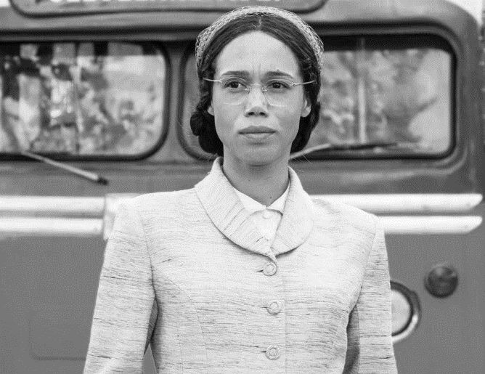

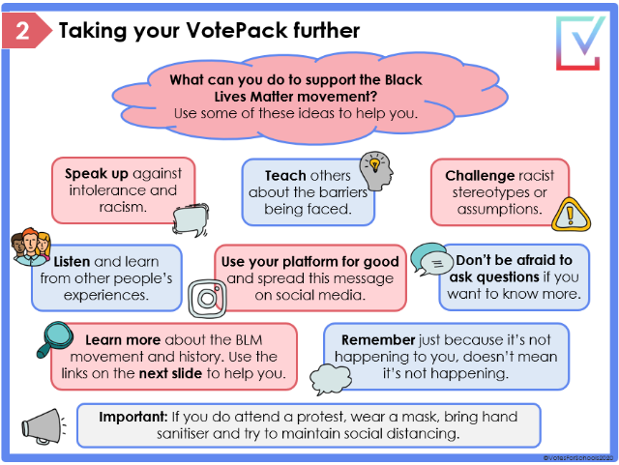
Call to Action
Quick idea
Learn through TV!
Interested in learning more about the Civil Rights Movement? Why not watch this episode of Doctor Who, all about Rosa Parks!
Get involved!
Feeling inspired? Find out how you can get involved and show your support in this week’s Home Learning Guide!
Big idea
Notes:
Alternative video link: https://www.bbc.co.uk/iplayer/episode/b0bpwm2m/doctor-who-series-11-3-rosa

Slide 33
Will the recent anti-racism protests lead to change in the US?
The world’s reaction to what happened to George Floyd shows that racism will not be accepted anymore.
This protest is bigger and stronger than ever before, with people all over the world taking part. If everyone stands up, there will be no space for racism.
Peaceful protests haven’t worked in the past, but this protest is louder and won’t stop until change happens.
…
Black people are still treated differently in many ways, so we’ve got a lot more to do more to end racism.
History shows that black people have been protesting for equal rights for many years – this protest helps but we still have a long way to go.
Breaking things and setting fires won’t help end racism. We need to educate people and teach them why racism is wrong.
…
Notes:
Parent/Carer Note: Use this slide to review the arguments before voting.

